Slide 1
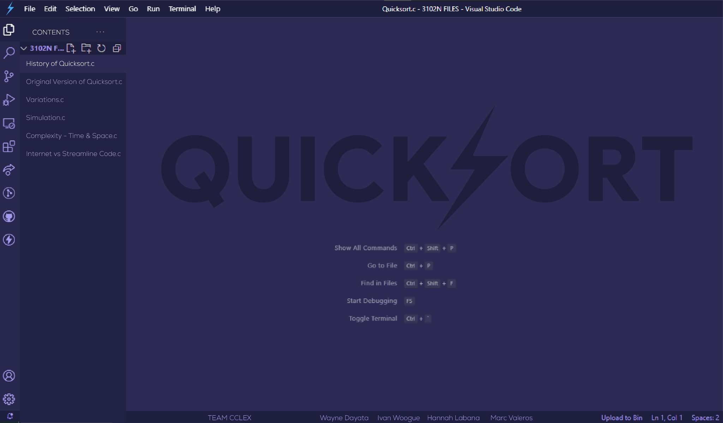

Slide 2
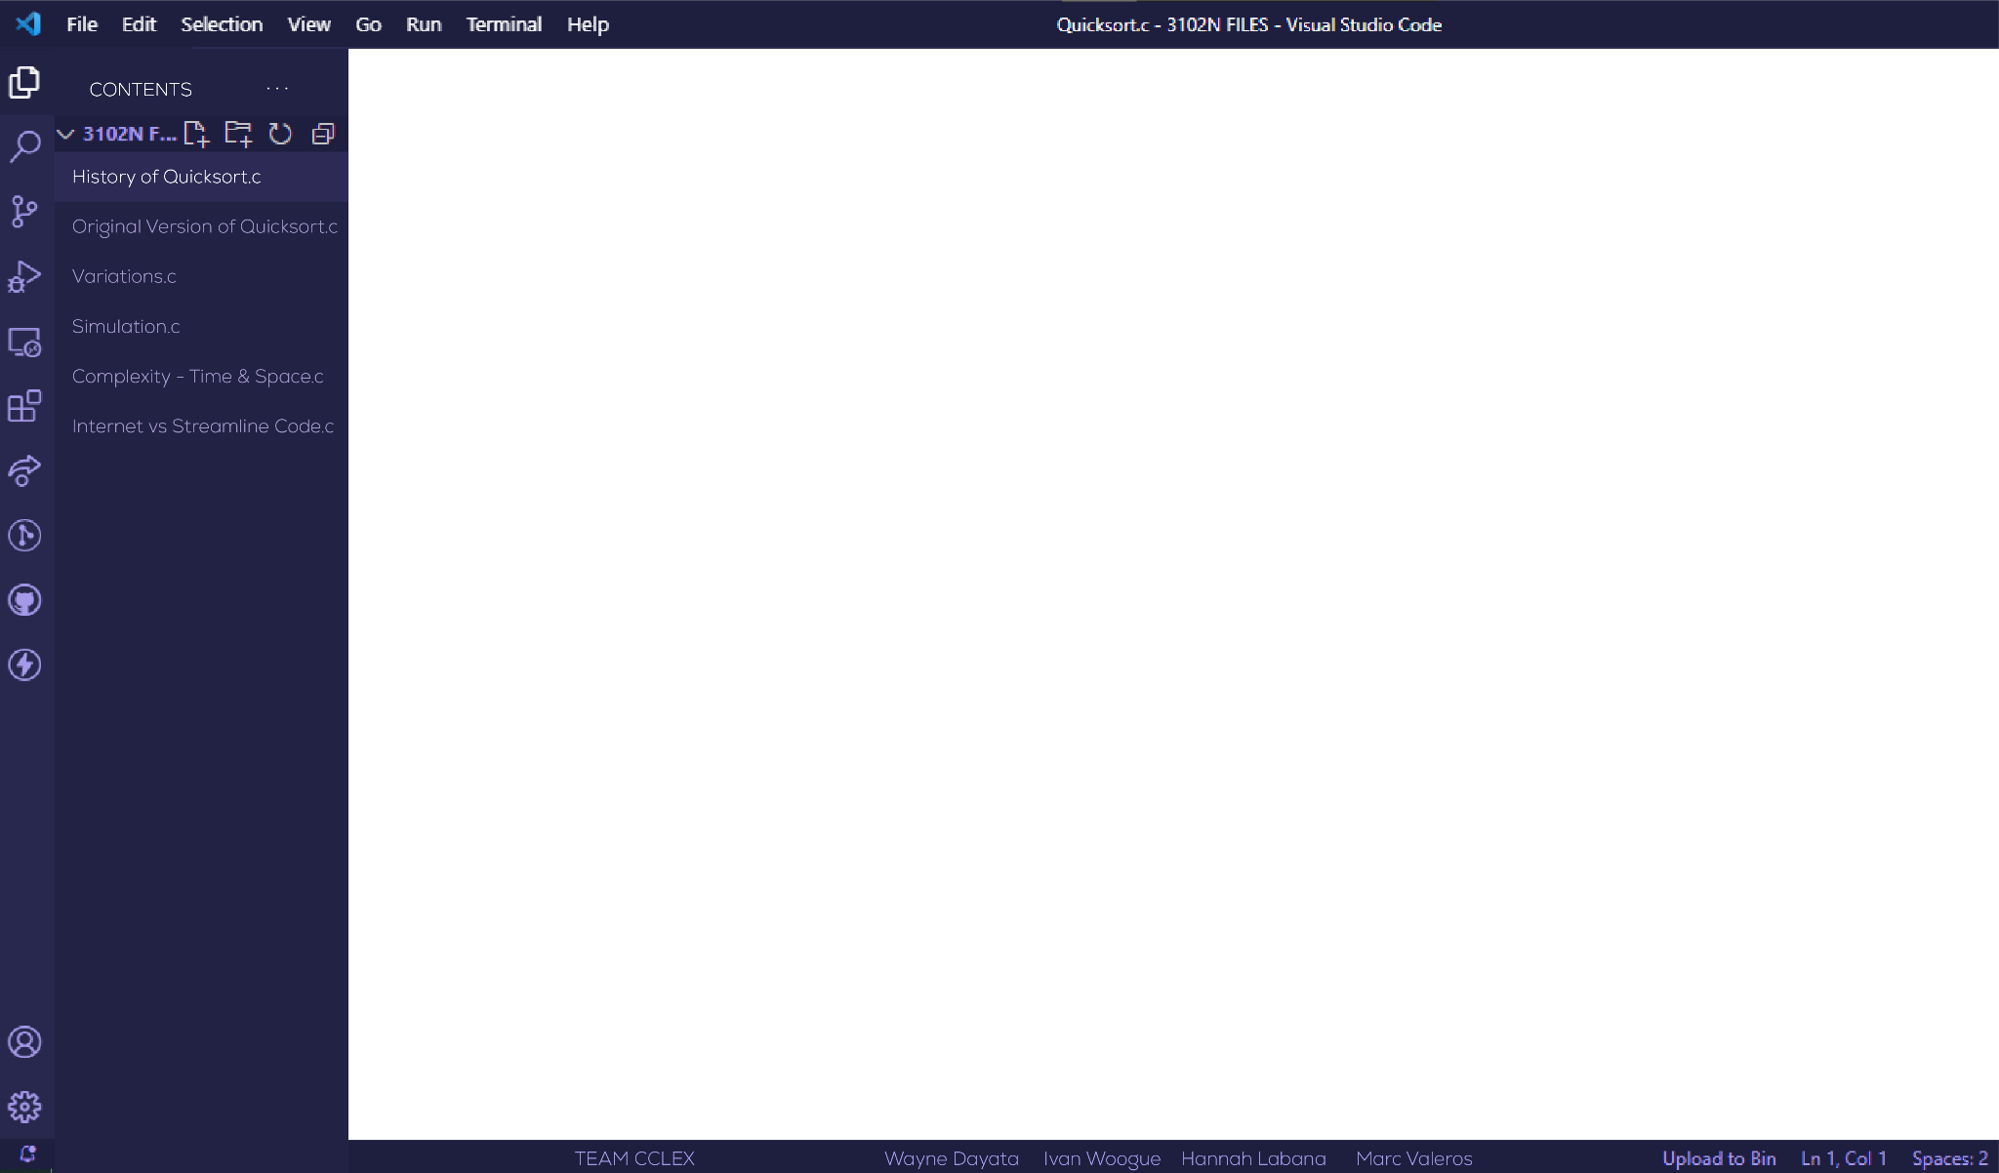

//QUICKSORT
Sir Charles Antony Richard Hoare
Tony Hoare(for short)
Invented in 1960

Slide 3
//Characteristics of Quicksort
Divide and conquer

Slide 4
Divide and Conquer
3 | 4 | 8 | 6 | 2 | 5 | 7 | 1
3 | 4 | 8 | 6
2 | 5 | 7 | 1
3 | 4
8 | 6
2 | 5
7 | 1
3 | 4
6 | 8
2 | 5
1 | 7
3 | 4 | 6 | 8
1 | 2 | 5 | 7
1 | 2 | 3 | 4 | 5 | 6 | 7 | 8

Slide 5
//Characteristics of Quicksort?
Divide and conquer
Recursive
Preorder
In-place
Unstable

Slide 6
Quicksort Pseudocode (Asc)
Given parameters A[SIZE], low, high
If low >= high : return
Initialize l to low+1 and h to high
Initialize partition to A[low]
While l < h
Starting from l to h, find an element where A[l] > partition
While h > l
Starting from h to l, find an element where A[h] <= partition
If l < h : Swap A[l] and A[h]
Else : Skip to 9
Repeat steps 5 to 7
Swap A[h] and A[low]
Call quicksort(), pass h-1 as high
Call quicksort(), pass h+1 as low
Note: partition/partitioning element

Slide 7
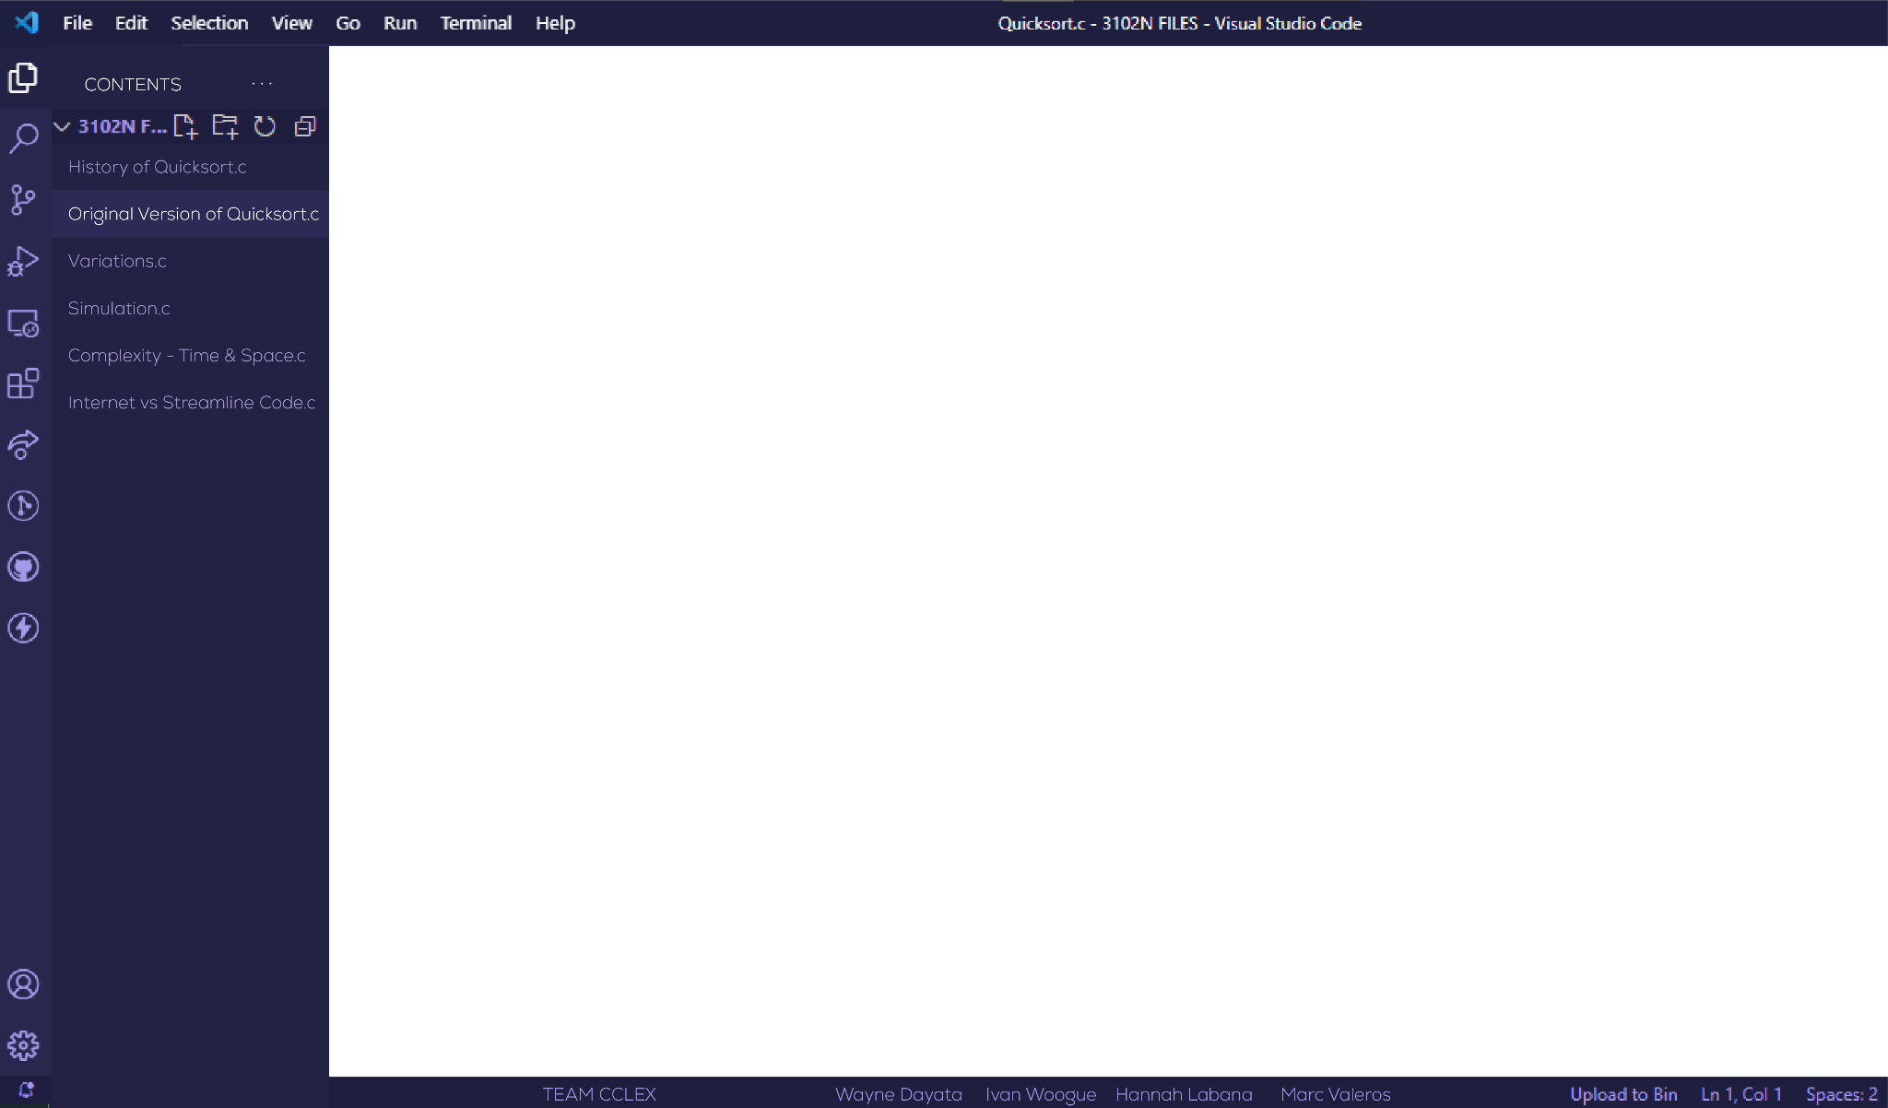
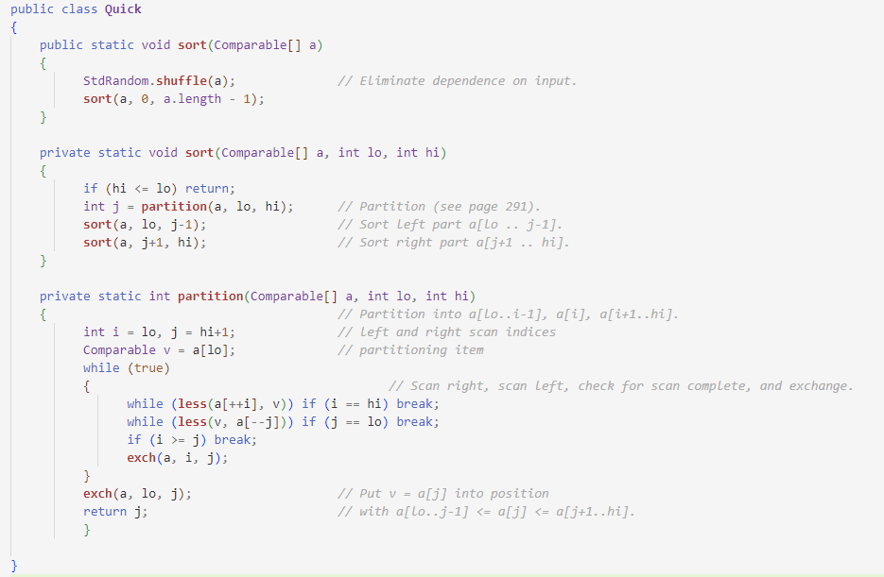
// Ascending Order
Book: Algorithms 4th Edition
A partitioning item is sorted
Index p of sorted item is returned
a[low…p-1] <= a[p] < a[p+1…p]

Slide 8
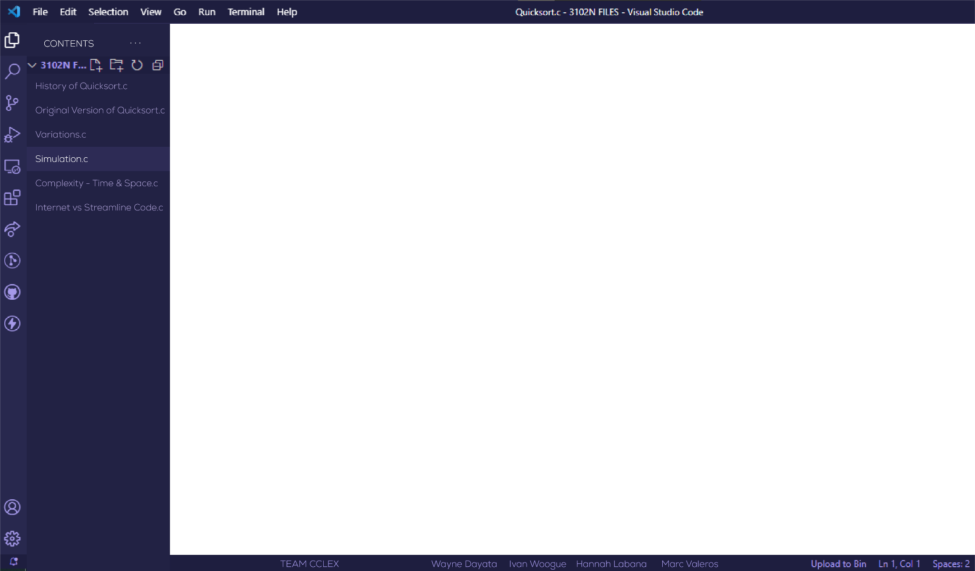
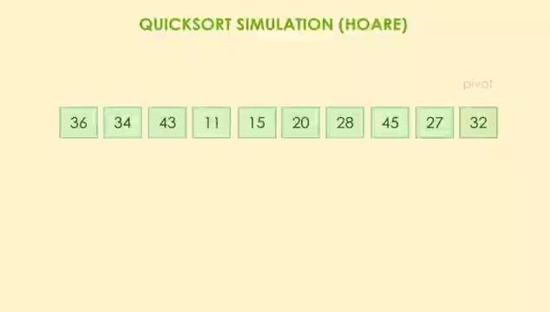

Slide 9
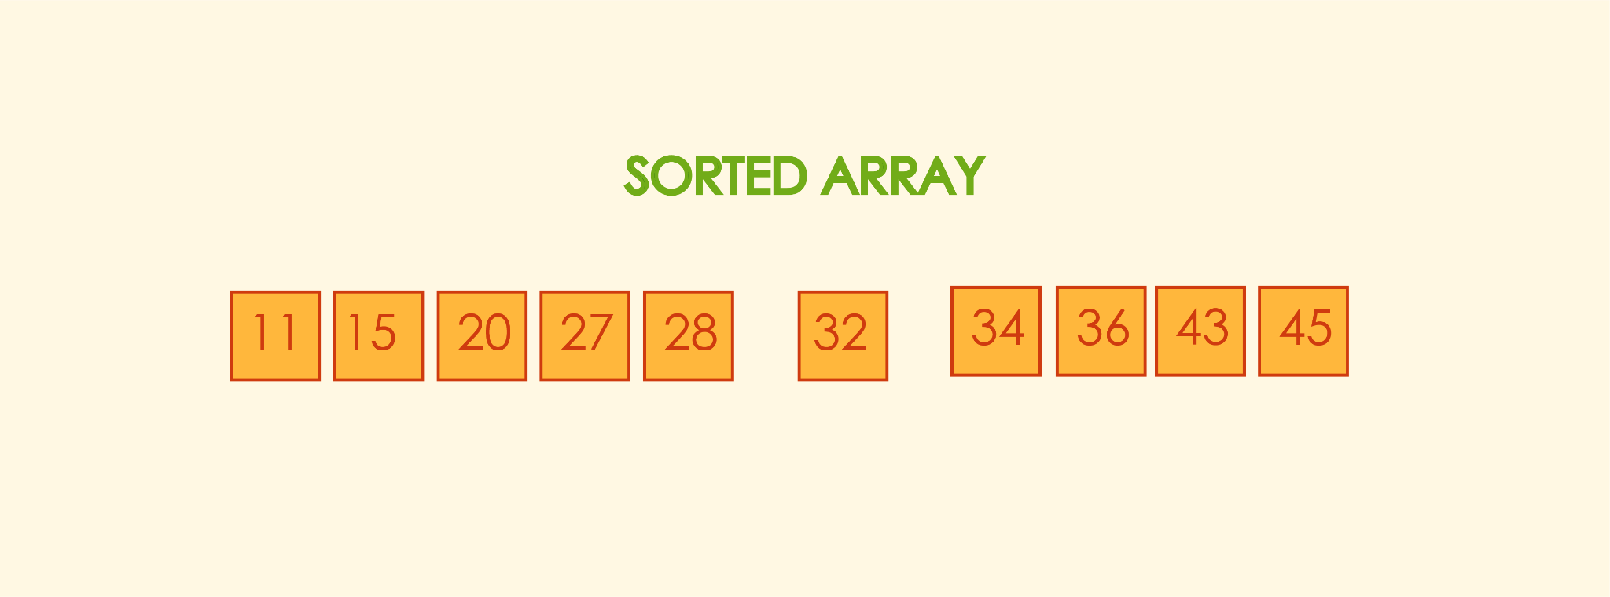

Slide 10
Lomuto’s Key Differences from Hoare’s Variation
Traversal
Efficiency
Simulation: https://www.figma.com/file/RO7V07QJec9T6kRxeE8vxK/Untitled

Slide 11

//VARIATIONS
Based on the pivot element position:
- first element, last element, and
selecting random position
Lomuto's variation
Median-of-three method
Shifting to insertion sort for calls with 5-7 or fewer elements.

Slide 12

//COMPLEXITY
Bringing Quicksort to Life: An Analysis of its Complexities
- time
- space

Slide 13
Consider the following array of values:
0 1 9 10 2 8 6 7 3 4 5
1 - 0 1 4 3 2 5 6 7 10 9 8
0 1 4 3 2 5
2 - 0 1 2 3 4
0 1
3 - 0 1
4 - 0
3 4
5 - 3 4
6 - 3
0 1 4 3 2 5 6 7 10 9 8
… … …
6 7 10 9 8
7 - 6 7 8 9 10
6 7
8 - 6 7
9 - 6
9 10
10- 9 10
11- 9
F - 0 1 2 3 4 5 6 7 8 9 10
/* COMMENTS */
- Number of recursive calls: 11
- Height of recursion tree: 3
- Notice that the pivot elements perfectly divide the two subarrays in the successive calls.
- Number of elements to traverse: Half of that in the previous calls.

Slide 14
Number of elements (n) = 11
n
log n
(11 -> 5 -> 2 -> 1)
Time complexity
(best case) O( )
Space complexity
(best case) O( )
log n
(Recall: BST
Preorder traversal)
/* COMMENTS */
- Number of recursive calls: 11
- Height of recursion tree: 3
- Notice that the pivot elements perfectly divide the two subarrays in the successive calls.
- Number of elements to traverse: Half of that in the previous calls.

Slide 15
How about this set of values?
9 8 7 6 5 4 3 2 1 0 10
1 - 9 8 7 6 5 4 3 2 1 0 10
9 8 7 6 5 4 3 2 1 0
2 - 0 8 7 6 5 4 3 2 1 9
8 7 6 5 4 3 2 1 9
3 - 8 7 6 5 4 3 2 1 9
8 7 6 5 4 3 2 1
4 - 1 7 6 5 4 3 2 8
7 6 5 4 3 2 8
5 - 7 6 5 4 3 2 8
0 1 7 6 5 4 3 2 8 9 10
… … …
7 6 5 4 3 2
6 - 2 6 5 4 3 7
6 5 4 3 7
7 - 6 5 4 3 7
6 5 4 3
8 - 3 5 4 6
5 4 6
9 - 5 4 6
5 4
10- 4 5
11- 5
F - 0 1 2 3 4 5 6 7 8 9 10
/* COMMENTS */
- Number of recursive calls: 11
- Height of recursion tree: 11
- Notice that the pivot elements could not divide the two partitions equally; instead, they end up being at either end of the array, thus leaving a significantly large chunk of elements far from their sorted positions.
- Number of elements to traverse: 1 less than that in the previous calls.

Slide 16
Number of elements (n) = 11
(11 -> 10 -> 9 … 1)
= n + n-1 + n-2 + … + 1
= n(n+1)/2 => O(n²)
n
n
Time complexity
(worst case)
O( x ) = O(n²)
Space complexity
(worst case) O( )
n
/* COMMENTS */
- Number of recursive calls: 11
- Height of recursion tree: 11
- Notice that the pivot elements could not divide the two partitions equally; instead, they end up being at either end of the array, thus leaving a significantly large chunk of elements far from their sorted positions.
- Number of elements to traverse: 1 less than that in the previous calls.

Slide 17
/* SCENARIOS */
- Number of recursive calls: n
- Number of elements to traverse: BEST: log n WORST: n
- Height of recursion tree: BEST: log n WORST: n
Number of elements (n) 600 60,000
Best case performance:
Recursion tree height: 10 16
Total array accesses: 4,987 1,025,619
Worst case performance:
Recursion tree height: 600 60,000
Total array accesses: 180,300 1,800,030,000

Slide 18
//POSSIBLE ALGORITHM IMPROVEMENTS
Applying the quicksort variations
- median of three
- cutoff to insertion sort

Slide 19
1. Median of three
- take the first, middle, and last elements then use the median as the pivot element
4 6 7 8 5 0 1 2 3 9 10
4 0 10
0 6 7 8 5 10 3 2 1 9 4
1 - 0 3 2 1 4 10 8 7 6 9 5
0 3 1
0 3 2 1
2 - 0 1 2 3
3 - 0
2 3
4 - 2 3
5 - 2
10 7 5
5 8 10 6 9 7
6 - 5 6 7 8 9 10
0 1 2 3 4 5 6 7 8 9 10
… … …
5 6
7 - 5 6
8 - 5
8 9 10
8 10 9
9 - 8 9 10
10- 8
11- 10
F - 0 1 2 3 4 5 6 7 8 9 10
/* COMMENTS */
- Number of recursive calls: 11
- Height of recursion tree: 11 -> 4
- Total elements traversed: 55 -> 21

Slide 20
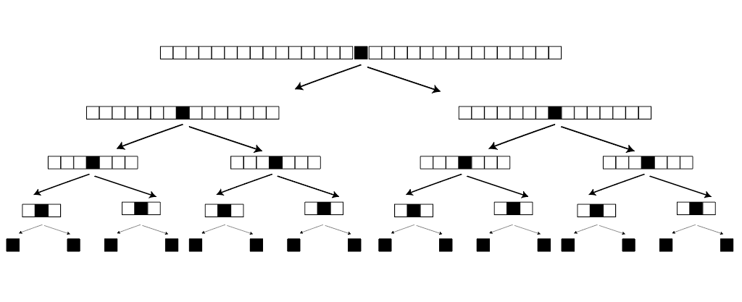
2. Cutoff to insertion sort
- switch to insertion sort as this works more efficiently on small array sizes (n<=7)
OK!
On no! Too many calls for small array sizes
Insertion sort!

Slide 21
2. Cutoff to insertion sort
- switch to insertion sort as this works more efficiently on small array sizes (n<=5)
9 8 7 6 5 4 3 2 1 0 10
9 4 10
4 8 7 6 5 10 3 2 1 0 9
1 - 4 8 7 6 5 0 3 2 1 9 10
4 5 1
1 8 7 6 5 0 3 2 4
2 - 1 2 3 0 4 6 7 8 5
(n=4)
3 - 0 1 2 3
0 1 2 3 4 6 7 8 5 9 10
… … …
(n=4)
4 - 5 6 7 8
(n=1)
5 - 10
F - 0 1 2 3 4 5 6 7 8 9 10
/* COMMENTS */
- Number of partition calls: 11 -> 2
- Number of insertion sort calls: 3
- Height of recursion tree: 11 -> 4 -> 3
- Total elements traversed: 55 -> 21 -> 32

Slide 22
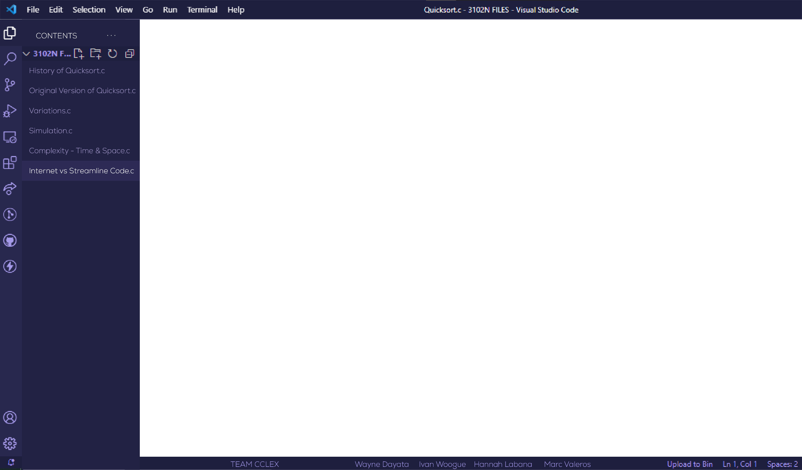
INTERNET CODE vs STREAMLINE CODE

